Slide 1


Houman Kazemzadeh
September, 2nd, 2024

Slide 2

Outline
Executive Summary
Introduction
Methodology
Results
Conclusion
Appendix

Slide 3
Executive Summary
Summary of methodologies
Summary of all results

Slide 4
Introduction
Project background and context
Problems you want to find answers

Slide 5

Section 1

Slide 6
Methodology
Executive Summary
Data collection methodology:
By using requests library, the Json file was obtained from the database, and was converted to a data frame using pandas. Only Falcon 9 data was maintained for future predictions and wrangling.
Perform data wrangling
By Importing NumPy and pandas, value_counts, isnull, and fillna was performed.
Perform exploratory data analysis (EDA) using visualization and SQL
Perform interactive visual analytics using Folium and Plotly Dash
Perform predictive analysis using classification models
Sklearn (preprocessing, train_test_split, GridSearchCV, Logistic Regression, Support Vector Machine, Decision Tree, KNN

Slide 7
Data Collection
Describe how data sets were collected.
You need to present your data collection process use key phrases and flowcharts
By using requests library, the Json file was obtained from the database, and was converted to a data frame using pandas. Only Falcon 9 data was maintained for future predictions and wrangling.

Slide 8
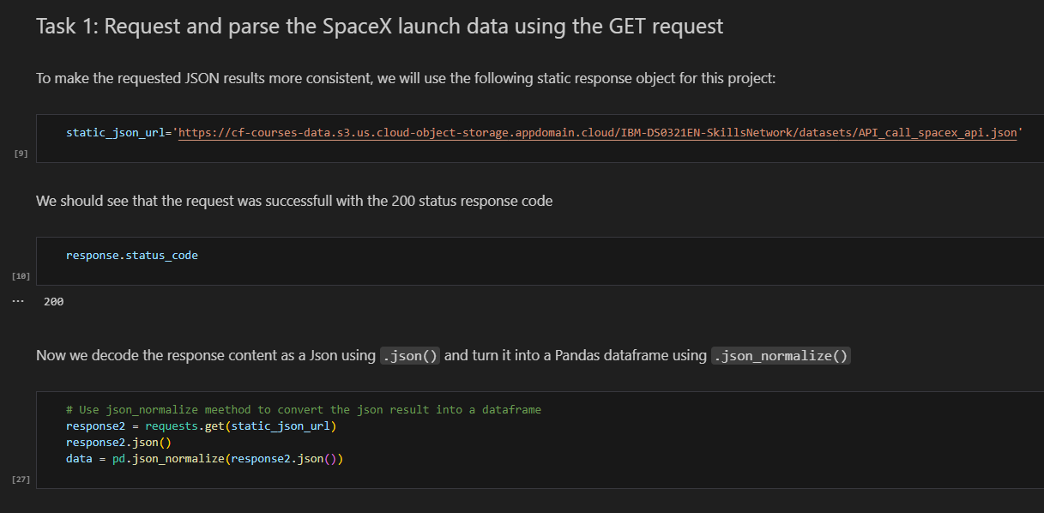
Data Collection – SpaceX API
Present your data collection with SpaceX REST calls using key phrases and flowcharts
Add the GitHub URL of the completed SpaceX API calls notebook (must include completed code cell and outcome cell), as an external reference and peer-review purpose

Slide 9
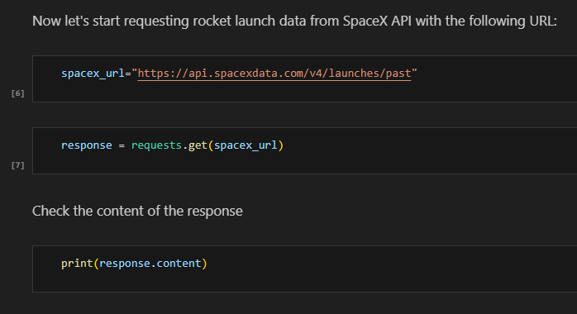
Data Collection - Scraping
Present your web scraping process using key phrases and flowcharts
Add the GitHub URL of the completed web scraping notebook, as an external reference and peer-review purpose

Slide 10
Data Wrangling
Describe how data were processed
You need to present your data wrangling process using key phrases and flowcharts
Add the GitHub URL of your completed data wrangling related notebooks, as an external reference and peer-review purpose
By Importing NumPy and pandas, value_counts, isnull, and fillna was performed.

Slide 11
EDA with Data Visualization
Summarize what charts were plotted and why you used those charts
Add the GitHub URL of your completed EDA with data visualization notebook, as an external reference and peer-review purpose
Pandas, NumPy and Seaborn were imported. Scatterplot, Bar plot, and line plot were illustrated to better understand the interactions between features and the results.

Slide 12
EDA with SQL
Using bullet point format, summarize the SQL queries you performed
Add the GitHub URL of your completed EDA with SQL notebook, as an external reference and peer-review purpose
Did not complete it

Slide 13
Build an Interactive Map with Folium
Summarize what map objects such as markers, circles, lines, etc. you created and added to a folium map
Explain why you added those objects
Add the GitHub URL of your completed interactive map with Folium map, as an external reference and peer-review purpose
Did not Complete it

Slide 14
Build a Dashboard with Plotly Dash
Summarize what plots/graphs and interactions you have added to a dashboard
Explain why you added those plots and interactions
Add the GitHub URL of your completed Plotly Dash lab, as an external reference and peer-review purpose
Did not complete it

Slide 15
Predictive Analysis (Classification)
Summarize how you built, evaluated, improved, and found the best performing classification model
You need present your model development process using key phrases and flowchart
Add the GitHub URL of your completed predictive analysis lab, as an external reference and peer-review purpose
Sklearn (preprocessing, train_test_split, GridSearchCV, Logistic Regression, Support Vector Machine, Decision Tree, KNN

Slide 16
Results
Exploratory data analysis results
Interactive analytics demo in screenshots
Predictive analysis results

Slide 17

Section 2

Slide 18
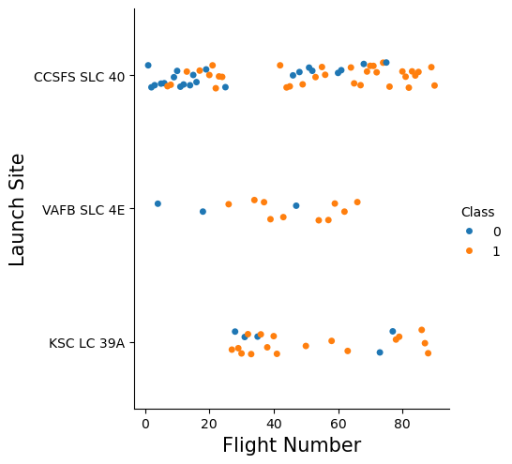
Flight Number vs. Launch Site
Show a scatter plot of Flight Number vs. Launch Site
Show the screenshot of the scatter plot with explanations
Launch Site Distribution: The majority of launches seem to have occurred at CCSFS SLC 40.VAFB SLC 4E has a smaller number of launches. KSC LC 39A has the fewest launches.
Class Distribution: Both blue and orange dots are present at all three launch sites, suggesting that both classes of launches have occurred at each location. The relative proportion of blue and orange dots at each site might indicate different success rates or other factors associated with the "Class" variable.
Trend with Flight Number: There doesn't appear to be a clear trend between Flight Number and Launch Site. The dots are scattered across the x-axis for each launch site.

Slide 19
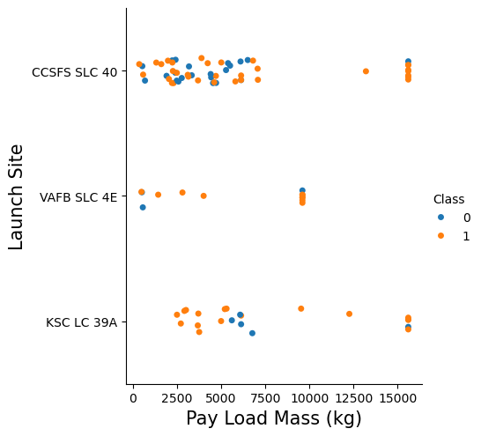
Payload vs. Launch Site
Show a scatter plot of Payload vs. Launch Site
Show the screenshot of the scatter plot with explanations
Payload Mass Distribution:The majority of launches have payloads below 10,000 kg.There are a few launches with significantly higher payload masses, particularly at CCSFS SLC 40.The distribution of payload masses varies across the launch sites.
Launch Site Distribution:CCSFS SLC 40 has the highest number of launches, with a wide range of payload masses.VAFB SLC 4E has a smaller number of launches, mostly concentrated in the lower payload mass range.KSC LC 39A has the fewest launches, with a mix of payload masses.
Class Distribution:Both blue and orange dots are present at all three launch sites, suggesting that both classes of launches have occurred at each location.The relative proportion of blue and orange dots at each site might indicate different success rates or other factors associated with the "Class" variable.
Relationship between Payload Mass and Launch Site:There seems to be a slight correlation between payload mass and launch site. For example, CCSFS SLC 40 has launches with a wider range of payload masses compared to VAFB SLC 4E.

Slide 20
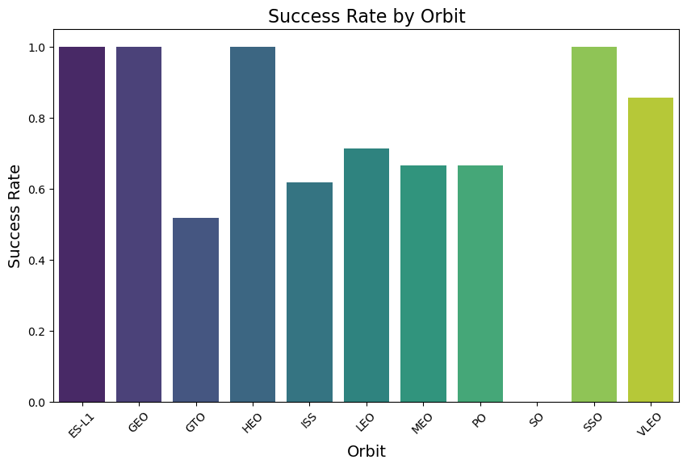
Success Rate vs. Orbit Type
Show a bar chart for the success rate of each orbit type
Show the screenshot of the scatter plot with explanations
Highest Success Rates:ES-L1, GEO, and HEO have the highest success rates, approaching 1.0.SSO also has a relatively high success rate.
Lowest Success Rates:ISS and VLEO have the lowest success rates.
Variability:There is a noticeable variation in success rates among the different orbits. Some orbits have consistently high success rates, while others have lower or more inconsistent performance.

Slide 21
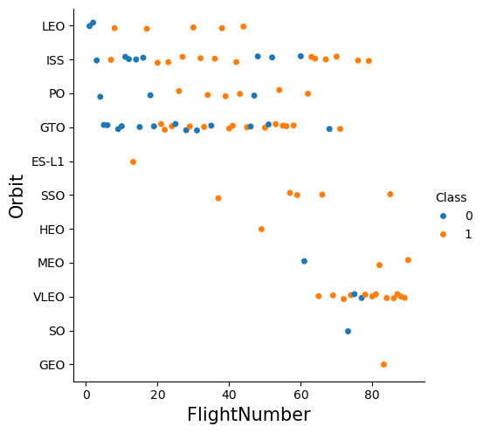
Flight Number vs. Orbit Type
Show a scatter point of Flight number vs. Orbit type
Show the screenshot of the scatter plot with explanations
Orbit Distribution:LEO, ISS, and PO have the highest number of launches.Other orbits, such as VLEO, SO, and GEO, have fewer launches.
Class Distribution:Both blue and orange dots are present for most orbits, suggesting that both classes of launches have occurred at different altitudes.The relative proportion of blue and orange dots for each orbit might indicate different success rates or other factors associated with the "Class" variable.
Trend with Flight Number:There doesn't appear to be a clear trend between Flight Number and Orbit. The dots are scattered across the x-axis for each orbit.

Slide 22
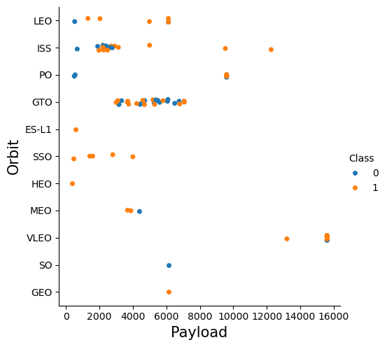
Payload vs. Orbit Type
Show a scatter point of payload vs. orbit type
Show the screenshot of the scatter plot with explanations
Payload Distribution:The majority of launches have payloads below 10,000 kg.There are a few launches with significantly higher payloads, particularly in the LEO and GTO orbits.The distribution of payload masses varies across the different orbits.
Orbit Distribution:LEO, ISS, and PO have the highest number of launches, with a wide range of payload masses.Other orbits, such as VLEO, SO, and GEO, have fewer launches, often with more limited payload capacities.
Class Distribution:Both blue and orange dots are present for most orbits, suggesting that both classes of launches have occurred at different altitudes.The relative proportion of blue and orange dots for each orbit might indicate different success rates or other factors associated with the "Class" variable.
Relationship between Payload and Orbit:There seems to be a correlation between payload and orbit. For example, LEO and GTO orbits often have higher payload capacities compared to other orbits.

Slide 23
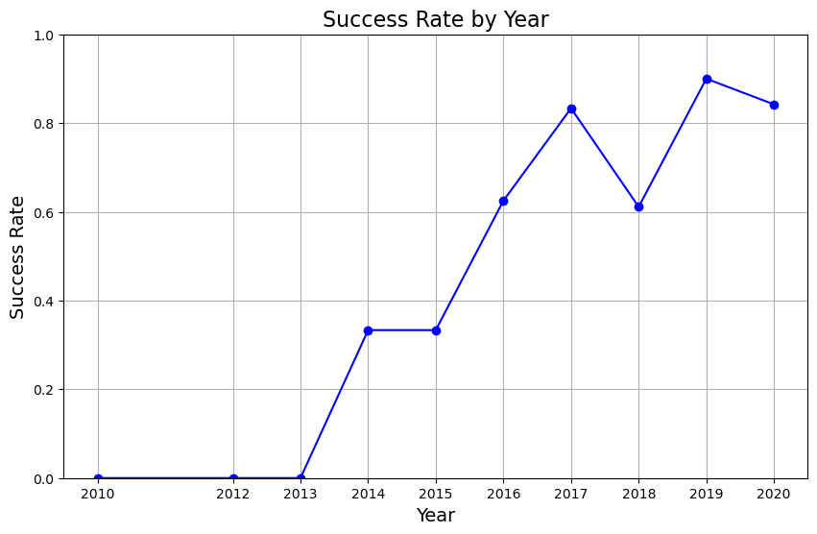
Launch Success Yearly Trend
Show a line chart of yearly average success rate
Show the screenshot of the scatter plot with explanations
Overall Trend:There is a clear upward trend in success rate over the years.The success rate starts low in 2010 and gradually increases, reaching its peak in 2019.In 2020, there is a slight decrease in success rate.
Specific Years:The years 2010, 2011, 2012, and 2013 had very low success rates.A significant improvement occurred between 2013 and 2014.There were fluctuations in success rate between 2015 and 2019.

Slide 24
All Launch Site Names
Find the names of the unique launch sites
LaunchSite
CCSFS SLC 40 55
KSC LC 39A 22
VAFB SLC 4E 13
Name: count, dtype: int64
Present your query result with a short explanation here
df["LaunchSite"].value_counts() to see unique values and their counts

Slide 25
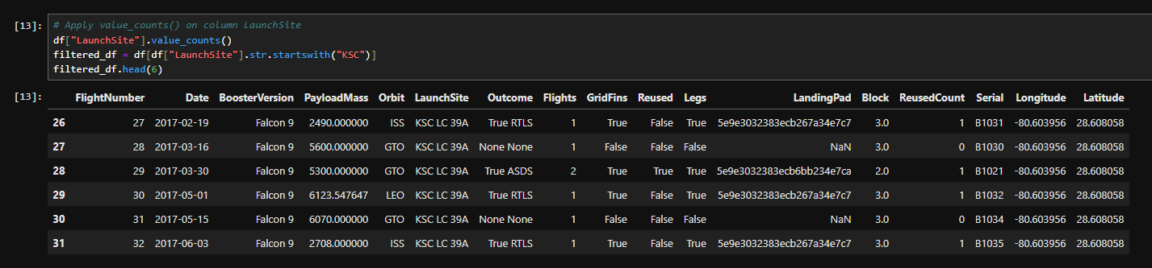
Launch Site Names Begin with 'KSC'
Find 5 records where launch sites’ names start with `KSC`
Present your query result with a short explanation here

Slide 26
Total Payload Mass
Calculate the total payload carried by boosters from NASA
Present your query result with a short explanation here

Slide 27
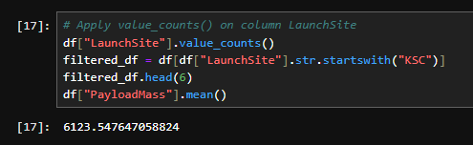
Average Payload Mass by F9 v1.1
Calculate the average payload mass carried by booster version F9 v1.1
Present your query result with a short explanation here

Slide 28
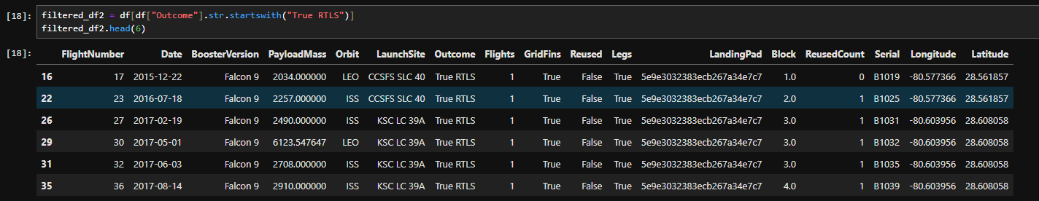
First Successful Ground Landing Date
Find the dates of the first successful landing outcome on drone ship.Present your query result with a short explanation here

Slide 29
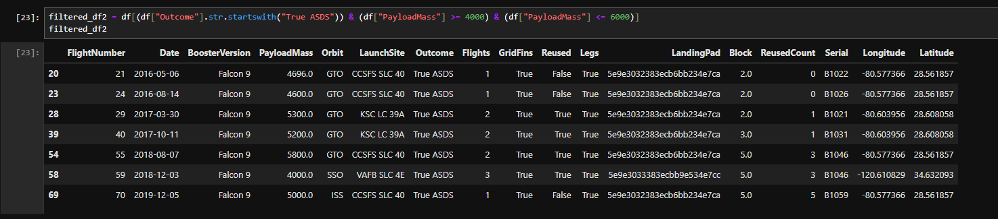
Successful Drone Ship Landing with Payload between 4000 and 6000
List the names of boosters which have successfully landed on drone ship and had payload mass greater than 4000 but less than 6000
Present your query result with a short explanation here

Slide 30
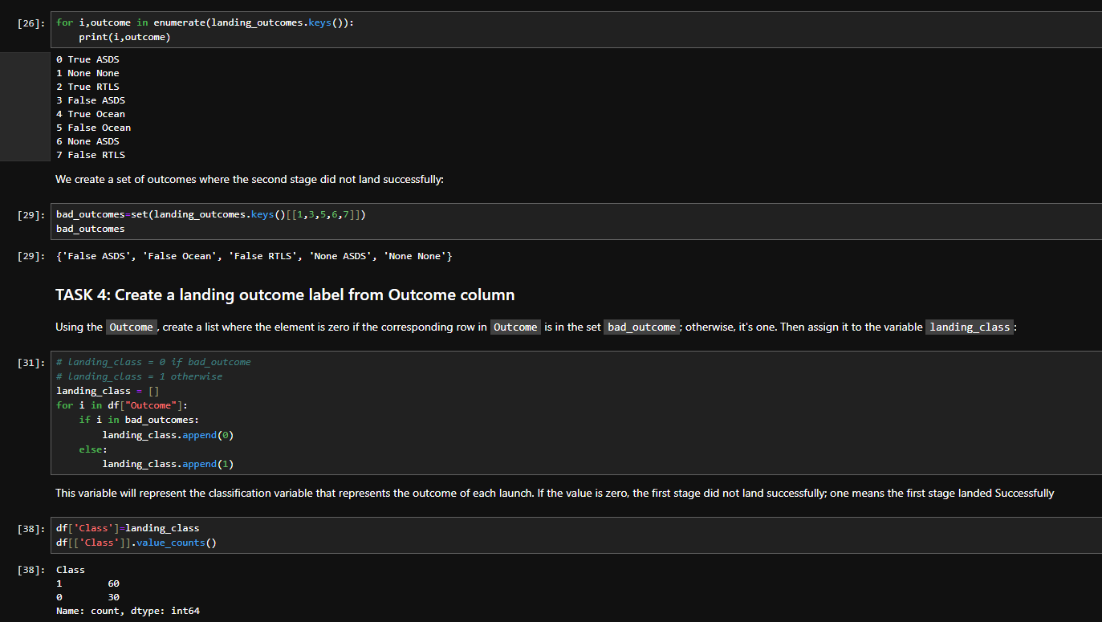
Total Number of Successful and Failure Mission Outcomes
Calculate the total number of successful and failure mission outcomes
Present your query result with a short explanation here

Slide 31
Boosters Carried Maximum Payload
List the names of the booster which have carried the maximum payload mass
Present your query result with a short explanation here

Slide 32
2015 Launch Records
List the records which will display the month names, succesful landing_outcomes in ground pad ,booster versions, launch_site for the months in year 2017
Present your query result with a short explanation here

Slide 33
Rank Landing Outcomes Between 2010-06-04 and 2017-03-20
Rank the count of landing outcomes (such as Failure (drone ship) or Success (ground pad)) between the date 2010-06-04 and 2017-03-20, in descending order
Present your query result with a short explanation here

Slide 34

Section 3

Slide 35
<Folium Map Screenshot 1>
Replace <Folium map screenshot 1> title with an appropriate title
Explore the generated folium map and make a proper screenshot to include all launch sites’ location markers on a global map
Explain the important elements and findings on the screenshot

Slide 36
<Folium Map Screenshot 2>
Replace <Folium map screenshot 2> title with an appropriate title
Explore the folium map and make a proper screenshot to show the color-labeled launch outcomes on the map
Explain the important elements and findings on the screenshot

Slide 37
<Folium Map Screenshot 3>
Replace <Folium map screenshot 3> title with an appropriate title
Explore the generated folium map and show the screenshot of a selected launch site to its proximities such as railway, highway, coastline, with distance calculated and displayed
Explain the important elements and findings on the screenshot

Slide 38

Section 4

Slide 39
<Dashboard Screenshot 1>
Replace <Dashboard screenshot 1> title with an appropriate title
Show the screenshot of launch success count for all sites, in a piechart
Explain the important elements and findings on the screenshot

Slide 40
<Dashboard Screenshot 2>
Replace <Dashboard screenshot 2> title with an appropriate title
Show the screenshot of the piechart for the launch site with highest launch success ratio
Explain the important elements and findings on the screenshot

Slide 41
<Dashboard Screenshot 3>
Replace <Dashboard screenshot 3> title with an appropriate title
Show screenshots of Payload vs. Launch Outcome scatter plot for all sites, with different payload selected in the range slider
Explain the important elements and findings on the screenshot, such as which payload range or booster version have the largest success rate, etc.

Slide 42

Section 5

Slide 43
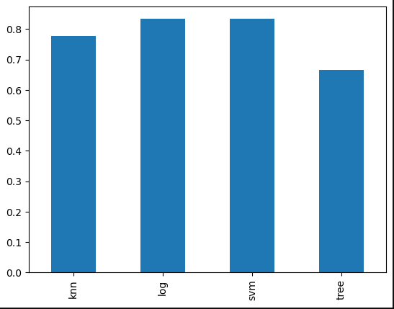
Classification Accuracy
Visualize the built model accuracy for all built classification models, in a bar chart
Find which model has the highest classification accuracy
Decision Tree was slightly better 86 percent

Slide 44
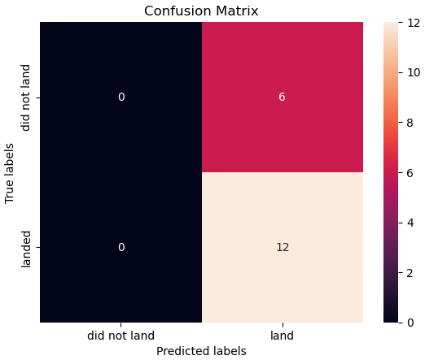
Confusion Matrix
Show the confusion matrix of the best performing model with an explanation
The model has a moderate accuracy of 67%.The model is particularly good at predicting "landed" instances (no false negatives), but it has a high false positive rate, meaning it often predicts "landed" when the true label is "did not land."This might indicate that the model is overly sensitive or prone to false alarms.

Slide 45
Conclusions
Point 1
Point 2
Point 3
Point 4
…

Slide 46
Appendix
Include any relevant assets like Python code snippets, SQL queries, charts, Notebook outputs, or data sets that you may have created during this project

Slide 47


